Slide 1
Automatic cyber threat detection and analysis
Jayaram P
CDAC

Slide 2
Plan
Basic Network Security
Firewalls
System Auditing
AI & ML

Slide 3
What is Threat Detection?
Practice of analyzing the entirety of a security ecosystem to identify any malicious activity that could compromise the network.
If a threat is detected, then mitigation efforts must be enacted to properly neutralize the threat before it can exploit any present vulnerabilities.
When it comes to detecting and mitigating threats, speed is crucial.
Security programs must be able to detect threats quickly and efficiently so attackers don’t have enough time to root around in sensitive data.

Slide 4
Several methods available in the defender's arsenal:
Leveraging Threat Intelligence:
way of looking at signature data from previously seen attacks and comparing it to enterprise data to identify threats.
Analyzing User and Attacker Behavior Analytics
With user behavior analytics, an organization is able to gain a baseline understanding of what normal behavior for an employee
what kind of data they access, what times they log on, and where they are physically located
With attacker behavior analytics, there's no "baseline" of activity to compare information to; instead, small, seemingly unrelated activities detected on the network over time

Slide 5
3. Setting Intruder Traps
Some targets are just too tempting for an attacker to pass up.
4.Conducting Threat Hunts
Threat Detection Requires a Two-Pronged Approach:
Security event threat detection technology
Network threat detection technology
Endpoint threat detection technology

Slide 6
Basic Network Security
Security Through Obscurity
Security through obscurity (STO) is a process of implementing security within a system by enforcing secrecy and confidentiality of the system's internal design architecture.
STO is based on the idea that any information system is secure as long as security vulnerabilities remain hidden.
create systems which attempt to be algorithmically secure.

Slide 7
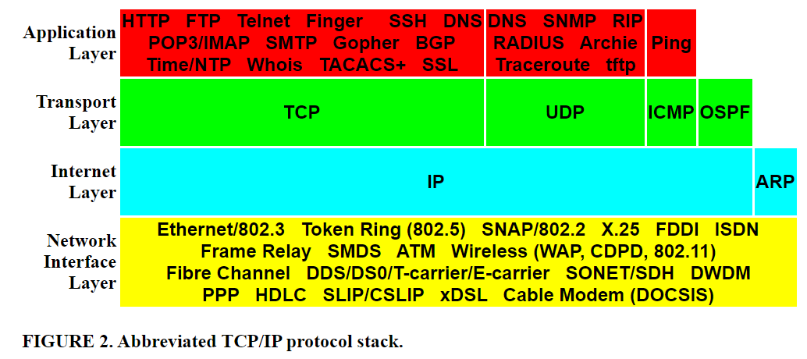
TCP/IP Evolution and Security
Notes:
Open Shortest Path First (OSPF)

Slide 8
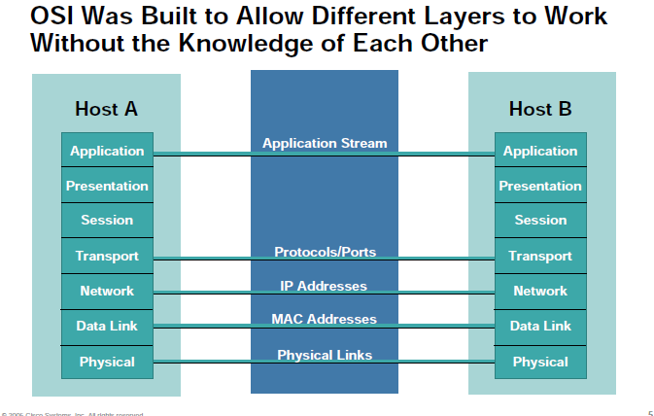

Slide 9
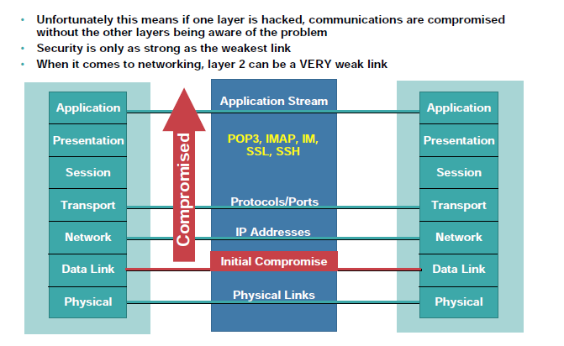

Slide 10
IP Spoofing
Spoofing is an impersonation of a user, device or client on the Internet. It’s often used during a cyber attack to disguise the source of attack traffic.
The most common forms of spoofing are:
DNS server spoofing – Modifies a DNS server in order to redirect a domain name to a different IP address. It’s typically used to spread viruses.
ARP spoofing – Links a perpetrator’s MAC address to a legitimate IP address through spoofed ARP messages. It’s typically used in denial of service (DoS) and man-in-the-middle assaults.
IP address spoofing – Disguises an attacker’s origin IP. It’s typically used in DoS assaults.

Slide 11
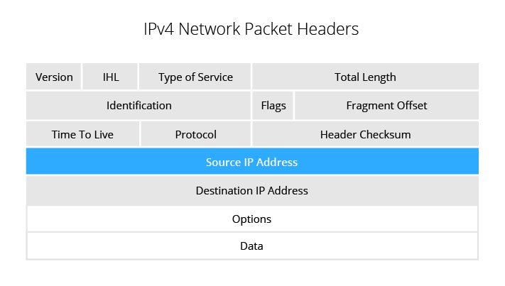

Slide 12
IP address spoofing is used for two reasons in DDoS attacks:
To mask botnet device locations
To stage a reflected assault.
IP address spoofing in application layer attacks
For application layer connections to be established, the host and visitor are required to engage in a process of mutual verification, known as a TCP three-way handshake.
The process consists of the following exchange
Visitor sends a SYN packet to a host.
Host replies with a SYN-ACK.
Visitor acknowledges receipt of the SYN-ACK by replying with an ACK packet.
Source IP spoofing makes the third step of this process impossible, as it prohibits the visitor from ever receiving the SYN-ACK reply, which is sent to the spoofed IP address.

Slide 13
Anti-spoofing in DDoS protection
To overcome this, modern mitigation solutions rely on deep packet inspection (DPI), which uses granular analysis of all packet headers rather than just source IP address.
With DPI, mitigation solutions are able to cross-examine the content of different packet headers to uncover other metrics to identify and filter out malicious traffic.
DPI is likely to cause performance degradation—sometimes even making the protected network almost completely unresponsive.

Slide 14
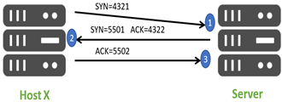
TCP Sequence Number Attack
sequence numbers play a big part in TCP communications.
TCP uses the sequence number field to take responsibility for ensuring that data packets are delivered to higher layers in the protocol stack in their correct order.
An attacker listening into a TCP exchange could in principle determine the flow of sequence numbers.

Slide 15
Anatomy of a TCP Sequence Prediction Attack
An attacker would spend some time monitoring the data flow.
The attacker would then cut off the other system (which is trusted by the target) from the communication, perhaps via a Denial of Service (DoS) attack.
Attacker prepares a packet with the source IP address of the trusted system, and the expected sequence number.
Measures to Prevent a TCP Sequence Prediction Attack
Internet Engineering Task Force (IETF) issued a renewed standard (RFC 6528) in 2012, setting out an improved algorithm for generating Initial Sequence Numbers.
Operating system manufacturers responded to the threat by introducing new and more unpredictable methods of sequence number generation

Slide 16
Packet Flooding
A UDP flood is a form of volumetric Denial-of-Service (DoS) attack where the attacker targets and overwhelms random ports on the host.
In this type of attack, the host looks for applications associated with these datagrams.
When none are found, the host issues a “Destination Unreachable” packet back to the sender.
System becomes inundated and therefore unresponsive to legitimate traffic.

Slide 17
How to Mitigate and Prevent a UDP Flood Attack?
Most operating systems attempt to limit the response rate of ICMP packets with the goal of stopping DDoS attacks.
Using deep packet inspection, can be used to balance the attack load across a network of scrubbing servers.
Scrubbing software that is designed to look at IP reputation, abnormal attributes and suspicious behavior, can uncover and filter out malicious DDoS packets.

Slide 18
Packet Sniffing
Packet sniffing is the practice of gathering, collecting, and logging some or all packets that pass through a computer network, regardless of how the packet is addressed.
When you install packet sniffing software, the network interface card (NIC)—the interface between your computer and the network—must be set to promiscuous mode.
Two main types of packet sniffers
Hardware Packet Sniffers
Plugged directly into the physical network at the appropriate location.
Software Packet Sniffers

Slide 19
Packet Filtering
Packet filtering is a network security mechanism that works by controlling what data can flow to and from a network.
The basic device that interconnects IP networks is called a router.
A router may be a dedicated piece of hardware that has no other purpose, or it may be a piece of software that runs on a general-purpose PC.
Packet filtering lets you control (allow or disallow) data transfer based on:
The address the data is (supposedly) coming from
The address the data is going to
The session and application protocols being used to transfer the data
Ex: Don't let anybody use Telnet (an application protocol) to log in from the outside.
or:
Let everybody send us email via SMTP (another application protocol).

Slide 20
Advantages of Packet Filtering
One screening router can help protect an entire network
Packet filtering doesn't require user knowledge or cooperation
Packet filtering is widely available in many routers
Disadvantages of Packet Filtering
Current filtering tools are not perfect
Some protocols are not well suited to packet filtering
Some policies can't readily be enforced by normal packet filtering routers

Slide 21
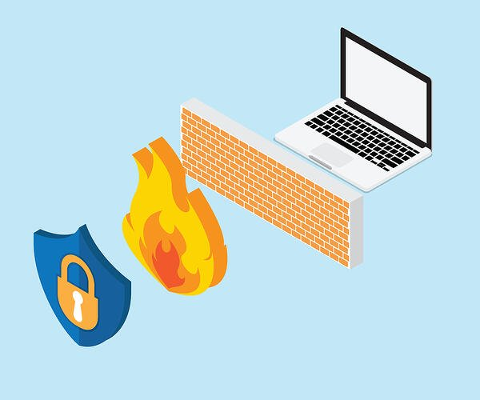
Firewalls
Types of Firewall Architectures
A firewall is a network security system designed to prevent unauthorized access to or from a private network.
All messages entering or leaving the intranet pass through the firewall.
It examines each message and blocks those that do not meet the specified security criteria.
Firewall types
Hardware
Software

Slide 22
There are several types of firewall techniques that will prevent potentially harmful information from getting through:
Packet Filter: Looks at each packet entering or leaving the network.
Application Gateway: Applies security mechanisms to specific applications, such as FTP and Telnet servers.
Circuit-level Gateway: Applies security mechanisms when a TCP or UDP connection is established. Once the connection has been made, packets can flow between the hosts without further checking.
Proxy Server: Intercepts all messages entering and leaving the network. The proxy server effectively hides the true network addresses.

Slide 23
Firewalls utilize following technologies for firewall architectures:
Static packet filter
Dynamic (state aware) packet filter
Circuit level gateway
Application level gateway (proxy)
Stateful inspection
Cutoff proxy
Air gap.

Slide 24
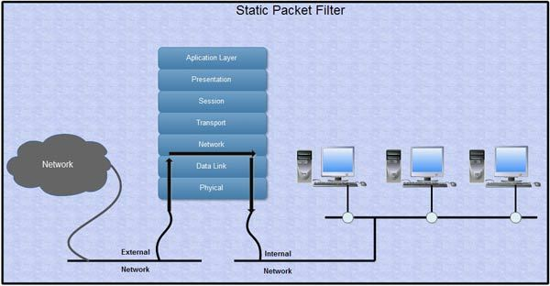
Static Packet Filter
Packet filtering policies may be based upon any of the following:
Allowing or disallowing packets on the basis of the source IP address (sender)
Allowing or disallowing packets on the basis of their destination port (service port)
Allowing or disallowing packets according to protocol.
Advantages
Low impact on network performance
Low cost.
Disadvantages
Operates only at network layer therefore it only examines IP and TCP headers
Unaware of packet payload-offers low level of security.
Lacks state awareness-may require numerous ports be left open to facilitate services that use dynamically allocated ports.
Susceptible to IP spoofing
Difficult to create rules (order of precedence).

Slide 25
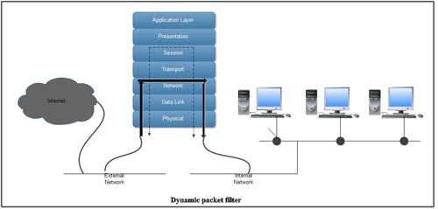
2. Dynamic (State Aware) Packet filter
A dynamic packet filter can monitor the state of active connections and use the information obtained to determine which network packets to allow through the firewall.
Advantages
Low cost
State awareness provides measurable .performance benefit, scalability and extensibility.
Disadvantages
Operates only at network layer therefore, it only examines IP and TCP headers.
Unaware of packet payload-offers low level of security
Susceptible to IP spoofing
Difficult to create rules (order of precedence)
Can introduce additional risk if connections
Can be established without following the RFC-recommended 3
way-handshake.

Slide 26
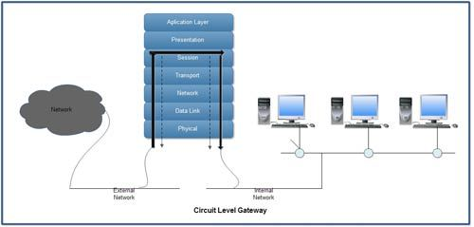
3. Circuit level Gateway
The circuit level gateway operates at the session layer-OSI layer 5.
Advantages
Low to moderate impact on network performance
Breaks direct connection to server behind firewall
Higher level of security than a static or dynamic (state aware) packet filter
Provides services for a wide range of protocols.
Disadvantages
Shares many of the same negative issues associated with packet filters
Allows any data to simply pass through the connection
Only provides for a low to moderate level of security.

Slide 27
4. Application level Gateway
A firewall that filters information at the application level blocks all IP traffic between the private network and the Internet.
The proxies are application specific
The proxies examine the entire packet and can filter packets at the application layer of the OSI model.
Advantages
Better logging handling of traffic
State aware of services (FTP etc.)
Strong application proxy that inspects protocol header lengths can eliminate an entire class of buffer overrun attacks
Highest level of security.
Disadvantages
Complex setup of application firewall needs more and detailed attentions to the applications that use the gateway.

Slide 28
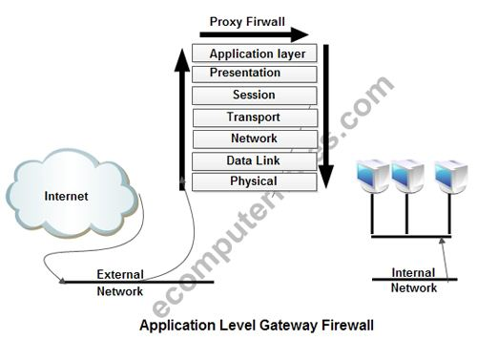

Slide 29
5. Stateful Inspection
Stateful inspection combines the many aspects of dynamic packet filtering, circuit level and application level gateways.
Stateful firewalls remember information about previously passed packets and are considered much more secure.
A unique limitation of one popular stateful inspection implementation is that it does not provide the ability to inspect sequence numbers on outbound packets from users behind the firewall.
Advantages
Offers the ability to inspect all seven layers of the OSI model and is user configurable to customize specific filter constructs
Does not break the client server model
Disadvantages
The single-threaded process of the stateful inspection engine has a dramatic impact on performance.

Slide 30
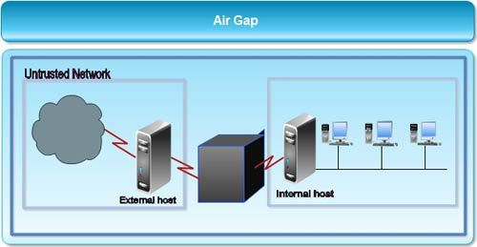
5. Air Gap
This is an extreme kind of firewall where there is no direct or automated connection between two devices.
Air gap technology provides a physical gap between trusted and untrusted networks
In air gap technology, the external client connection "causes the connection data to be written to an SCSI e-Disk.
The internal connection then reads this data from the SCSI e-Disk.
Advantages
Inside is insulated from outside
Packets are not "automatically" passed through
Only explicitly launched services work
No unexpected traffic via other sockets.

Slide 31
System Auditing
What Is an IT Security Audit?
A network security audit is a technical assessment of an organization’s IT infrastructure—their operating systems, applications, and more.
Who can conduct an audit in the first place
Internal Auditors
External Auditors
Manual Audits
Automated Audits

Slide 32
IT security standards in existence today
ISO Compliance
The ISO/IEC 27000 family of standards are some of the most relevant to system administrators, as these standards focus on keeping information assets secure.
HIPAA Security Rule:
The HIPAA Security Rule outlines specific guidelines pertaining to exactly how organizations should protect patients’ electronic personal health information.
PCI DSS Compliance:
The PCI DSS compliance standard applies directly to companies dealing with any sort of customer payment.
Automated Audit Assessment Tools:
SolarWinds Access Rights Manager
ManageEngine EventLog Manager

Slide 33
Web Application Security
Common Web App Vulnerabilities
According to OWASP, the top 10 most common application vulnerabilities include:
Injection. An injection happens when a bad actor sends invalid data to the web app to make it operate differently from the intended purpose of the application.
Broken Authentication. A broken authentication vulnerability allows a bad actor to gain control over an account within a system or the entire system.
Sensitive Data Exposure. Sensitive data exposure means data is vulnerable to being exploited by a bad actor when it should have been protected.
XML External Entities (XXE). A type of attack against an application that parses XML input and occurs when XML input containing a reference to an external entity is processed by a weakly configured XML parser.
Broken Access Control. When components of a web application are accessible instead of being protected like they should be, leaving them vulnerable to data breaches.

Slide 34
6. Security Misconfigurations. Incorrectly misconfiguring a web application provides bad actors with an easy way in to exploit sensitive information.
7. Cross Site Scripting (XSS). An XSS attack means a bad actor injects malicious client-side scripts into a web application.
8. Insecure Deserialization. Bad actors will exploit anything that interacts with a web application—from URLs to serialized objects—to gain access.
9. Using Components with Known Vulnerabilities. Instances such as missed software and update change logs can serve as big tip-offs for bad actors looking for ins into a web application. Disregarding updates can allow a known vulnerability to survive within a system.
10. Insufficient Logging and Monitoring. Lack of efficient logging and monitoring processes increases the chances of a web app being compromised.

Slide 35
Practical Solutions for Protecting Web Apps:
Passive Protection:
Active Protection: to protect against browser data exfiltration
Real-Time Threat Notification: to alert the business if code, page tampering or analysis is attempted that can initiate an immediate operational response — such as shutting down attacker accounts or updating web code protection to counter an attack.

Slide 36
Intrusion Detection Systems
How an IDS Works
An IDS deploys sensors that monitor designated key points throughout an IT network.
Administrators develop detection content that they distribute throughout the IDS platform.
An IDS captures small amounts of security-critical data and transmits it back to the administrator for analysis.
When a cyber attack occurs, the IDS detects the attack in real-time.
IDS administrators can address and disrupt cyber attacks as they occur.
Afterward, the IDS can perform an assessment of the attack to determine weaknesses in the network.

Slide 37
Types of Intrusion Detection Systems
Host-Based IDS: operate on individual desktop or remote devices within a network.
Network-Based IDS: monitor activity across strategic points over an entire network.
Stack IDS: monitor network packets in transit through the network stack (TCP/IP).
Signature-Based IDS: searches a string of malicious bytes or sequences.
Anomaly-Based IDS: works on the concept of a baseline for network behavior.

Slide 38
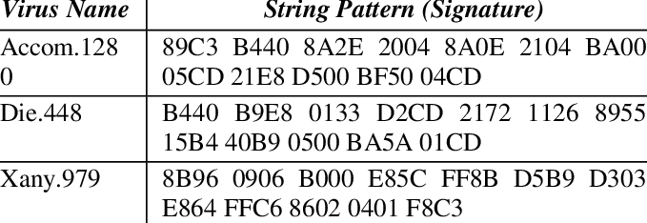

Slide 39
Design of SIEM
Security Information and Event Management (SIEM) can be an extraordinary benefit to an organization's security posture.
Tools:
Cloud SIEM
Elasticsearch
Elasticsearch is a real-time, distributed storage, search, and analytics engine.
Kibana : for Visualization

Slide 40
AI Systems for real time threat detection
ML has the power to comprehend threats in real time, to understand the infrastructure of a company.
From a threat-detection perspective, ML is a game-changer
Reducing false positives

Slide 41
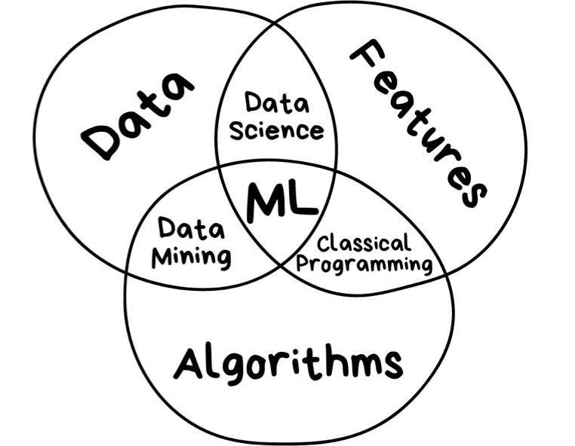
Machine Learning for Cybersecurity
AI (Artificial Intelligence) — a broad concept.A Science of making things smart or, in other words, human tasks performed by machines.
ML (Machine Learning) — an Approach(just one of many approaches) to AI that uses a system that is capable of learning from experience.
DL (Deep Learning) — a set of Techniques for implementing machine learning that recognize patterns of patterns - like image recognition.

Slide 42
Most of tasks are subclasses of the most common ones, which are described below.
Regression (or prediction) — a task of predicting the next value based on the previous values.
Classification — a task of separating things into different categories.
Clustering — similar to classification but the classes are unknown, grouping things by their similarity.
Association rule learning (or recommendation) — a task of recommending something based on the previous experience.
Dimensionality reduction — or generalization, a task of searching common and most important features in multiple examples.
Generative models — a task of creating something based on the previous knowledge of the distribution.

Slide 43
Machine Learning tasks and Cyber security:
Regression:
It can be applied to fraud detection. The features (e.g., the total amount of suspicious transaction, location, etc.) determine a probability of fraudulent actions.
Classification:
a spam filter separating spams from other messages can serve as an example. Spam filters are probably the first ML approach applied to Cyber security tasks.
Association Rule Learning:
For incident response

Slide 44
There are three dimensions (Why, What, and How).
Security tasks can be divided into five categories:
prediction
prevention
detection
response
monitoring

Slide 45
The second dimension is a technical layer and an answer to the “What” question:
Network (network traffic analysis and intrusion detection);
Endpoint (anti-malware);
Application (WAF or database firewalls);
User
Process (anti-fraud).
The third dimension is a question of “How” (e.g., how to check security of a particular area):
in transit in real time;
at rest;
historically;

Slide 46
Machine learning for Network Protection
regression to predict the network packet parameters and compare them with the normal ones;
classification to identify different classes of network attacks such as scanning and spoofing;
clustering for forensic analysis.
Machine learning for Endpoint Protection
regression to predict the next system call for executable process and compare it with real ones;
classification to divide programs into such categories as malware, spyware and ransomware;
clustering for malware protection on secure email gateways (e.g., to separate legal file attachments from outliers).

Slide 47
Machine learning for Application Security:
To remind you, Application security can differ. There are web applications, databases, ERP systems, SaaS applications, micro services, etc.
It’s almost impossible to build a universal ML model to deal with all threats effectively in near future.
ML can be applied as below
regression to detect anomalies in HTTP requests (for example, XXE and SSRF attacks and auth bypass);
classification to detect known types of attacks like injections (SQLi, XSS, RCE, etc.);
clustering user activity to detect DDOS attacks and mass exploitation.

Slide 48
Machine learning for Process Behavior:
regression to predict the next user action and detect outliers such as credit card fraud;
classification to detect known types of fraud;
clustering to compare business processes and detect outliers.

Slide 49
Deep Learning in Cybersecurity:
1. Intrusion Detection and Prevention Systems (IDS/IPS)
Deep learning, convolutional neural networks and Recurrent Neural Networks (RNNs) can be applied to create smarter ID/IP systems
2. Dealing with Malware
Traditional malware solutions such as regular firewalls detect malware by using a signature-based detection system.
Deep learning algorithms are capable of detecting more advanced threats and are not reliant on remembering known signatures and common attack patterns.
They learn the system and can recognize suspicious activities
3. Spam and Social Engineering Detection
Natural Language Processing (NLP), a deep learning technique, can help you to easily detect and deal with spam

Slide 50
4. Network Traffic Analysis:
Deep learning ANNs are showing promising results in analyzing HTTPS network traffic to look for malicious activities. This is very useful to deal with many cyber threats such as SQL injections and DOS attacks.
5. User Behavior Analytics

Slide 51

Thank You
jayaram@cdac.in

